Slide 1
Advanced Structural Modeling 1
Unit-II
Part-B

Slide 2
Topics to be covered
Advanced Classes
Advanced Relationships

Slide 3
Advanced Classes

Slide 4
Introduction
Classes are the most important building block of any object-oriented system.
Classes are kind of general building block in the UML – classifiers.
A classifier is a mechanism that describes structural and behavioral features.
Classifiers include classes, interfaces, datatypes, signals, components, nodes, use cases, and subsystems.

Slide 5
Introduction
Classifiers (and especially classes) have a number of advanced features beyond the simpler properties of attributes and operations.
You can model multiplicity, visibility, signatures, polymorphism, and other characteristics.

Slide 6
Getting Started
The UML provides a representation for a number of advanced properties, as shown in below Figure.
This notation permits you to visualize, specify, construct, and document a class to any level of detail you wish, even sufficient to support forward and reverse engineering of models and code.

Slide 7
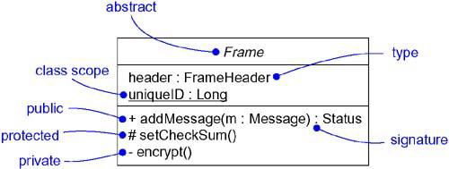
Getting Started

Slide 8
Terms and Concepts
Classifiers
Visibility
Scope
Abstract, Root, Leaf and Polymorphic Elements
Multiplicity
Attributes
Operations
Template classes
Standard elements

Slide 9
Classifiers
A classifier is a mechanism that describes structural and behavioral features.
Classifiers include classes, interfaces, datatypes, signals, components, nodes, use cases, and subsystems.

Slide 10
Classifiers
Some things in the UML don't have instances. Example - packages and generalization relationships.
Modeling elements that can have instances are called classifiers.
A classifier has structural features (in the form of attributes), as well as behavioral features (in the form of operations).
Every instance of a given classifier shares the same features.

Slide 11
Classifiers
The most important kind of classifier in the UML is the class.
A class is a description of a set of objects that share the same attributes, operations, relationships, and semantics.
Classes are not the only kind of classifier, UML provides a number of other kinds of classifiers to help you model.

Slide 12
Classifiers
S.No | Classifier | Description
1 | Class | A class is a blueprint or a template for its objects
2 | Interface | It is collection of operations that must be realized by another element
3 | Datatype | A type whose values have no identity
4 | Signal | An asynchronous event communicated between objects
5 | Component | A physical and replaceable part of a system
6 | Node | A physical element that exists at run time and that represents a computational resource
7 | Use case | A description of a set of a sequence of actions, including variants, that a system performs that yields an observable result of value to a particular actor
8 | Subsystem | A grouping of elements of which specify the behavior of a part of the system

Slide 13
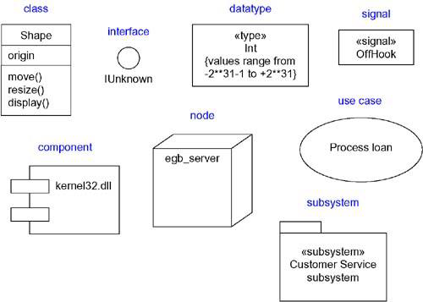
Classifiers
Graphically, the UML distinguishes among these different classifiers, as shown in below Figure.
Fig: Classifiers

Slide 14
Visibility
One of the most important details you can specify for a classifier's attributes and operations is its visibility.
The visibility of a feature specifies whether it can be used by other classifiers or not.
In the UML, you can specify any of three levels of visibility.

Slide 15
Visibility
S.No | Name | Symbol | Description
1 | Public | + | Any outside classifier with visibility to the given classifier can use the feature
2 | Protected | # | Any descendant of the classifier can use the feature
3 | Private | - | Only the classifier itself can use the feature
4 | Package | ~ | Any outside classifier can use but with in the package

Slide 16
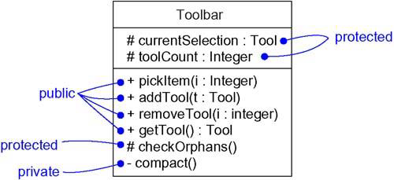
Visibility

Slide 17
Scope
Another important detail you can specify for a classifier's attributes and operations is its owner scope.
The scope of an attribute or an operation denotes whether they have their existence in all the instances of the classifier or only one copy is available and is shared across all the instances of the classifier.
In the UML, you can specify two kinds of owner scope.

Slide 18
Scope
S.No | Scope | Description
1 | Instance | Each instance of the classifier holds its own value for the feature.
2 | classifier | There is just one value of the feature for all instances of the classifier.
Most features of the classifiers you model will be instance scoped.
The most common use of classifier scoped features is for private attributes that must be shared among a set of instances

Slide 19
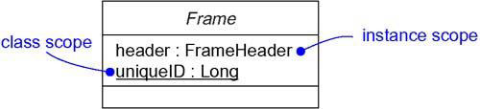
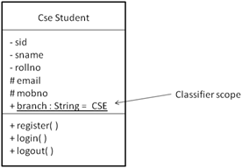
Scope

Slide 20
Abstract, Root, Leaf, and Polymorphic Elements
While developing class diagrams, it is common to use generalization relationship to model generalization-specialization relationships between a group of classes.
The classes at the top of the hierarchy are more generalized or abstract and the classes lower in the hierarchy are more specialized.

Slide 21
Abstract, Root, Leaf, and Polymorphic Elements
To represent abstract classes for which we cannot create instances, the class name is written in italics in UML.
To represent abstract methods, we write the operation signature in italics.
We can also represent leaf and root classes in UML.
A class which has no child classes is known as a leaf class. Such a class can be represented by writing leaf as a property under the class name.

Slide 22
Abstract, Root, Leaf, and Polymorphic Elements
Similarly, a class with no parents is known as a root class and such a class can be represented by writing root as a property as a property under the class name.
In class hierarchies it is common for the classes to have methods with same signatures.
This feature of declaring methods with same signatures is known as polymorphism. Such methods are represented in UML by writing their signatures in italics.

Slide 23
Abstract, Root, Leaf, and Polymorphic Elements
We can also specify that a method cannot be overrided by marking the method with the leaf property written beside the method signature.

Slide 24
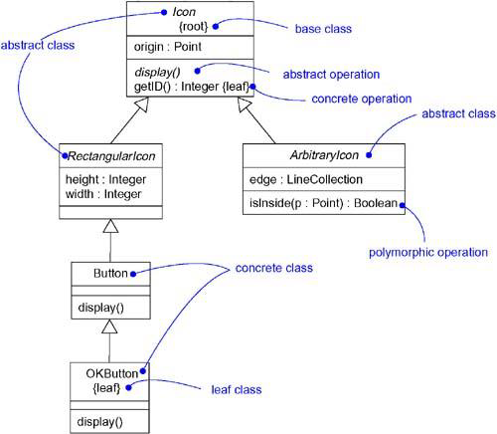
Abstract, Root, Leaf, and Polymorphic Elements

Slide 25
Multiplicity
Whenever you use a class, it's reasonable to assume that there may be any number of instances of that class.
Sometimes, you want to restrict the number of instances a class may have.
Most often, you want to specify zero instances (utility class), one instance (a singleton class), a specific number of instances, or many instances (the default case).

Slide 26
Multiplicity
The number of instances a class may have is called its multiplicity.
Multiplicity is a specification of the range of allowable cardinalities an entity may assume.
In the UML, you can specify the multiplicity of a class by writing a multiplicity expression in the upper-right corner of the class icon.

Slide 27
Multiplicity
Multiplicity applies to attributes also.
You can specify the multiplicity of an attribute by writing a suitable expression in brackets just after the attribute name.

Slide 28
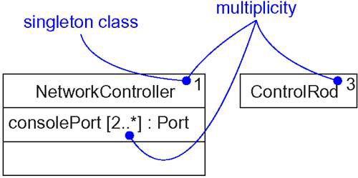
Multiplicity

Slide 29
Attributes
While modeling classes, it is reasonable to write only the attribute name.
Along with the name, you can also specify the visibility, scope, and multiplicity of each attribute.
You can also specify the type, initial value, and changeability of each attribute.

Slide 30
Attributes
The syntax of an attribute in UML is:
[visibility] name [multiplicity] [: type]
[= initial-value] [{property-string}]

Slide 31
Attributes
For example, the following are all legal attribute declarations:
origin | Name only
+ origin | Visibility and name
origin : Point | Name and type
head : *Item | Name and complex type
name [0..1] : String | Name, multiplicity, and type
origin : Point = (0,0) | Name, type, and initial value
id : Integer {frozen} | Name and property

Slide 32
Attributes
There are three defined properties that you can use with attributes.
S.No | Properties | Description
1 | changeable | There are no restrictions on modifying the attribute's value.
2 | addOnly | For attributes with a multiplicity greater than one, additional values may be added, but once created, a value may not be removed or altered.
3 | frozen | The attribute's value may not be changed after the object is initialized.
Unless otherwise specified, attributes are always changeable. You'll mainly want to use frozen when modeling constant or write-once attributes.

Slide 33
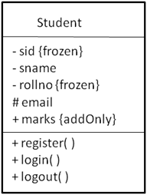
Attributes

Slide 34
Operations
While modeling classes, you will simply write each operation's name.
You can also specify the visibility and scope of each operation.
You can also specify the parameters, return type, concurrency semantics, and other properties of each operation.
The name of an operation plus its parameters (including its return type, if any) is called the operation's signature.

Slide 35
Operations
the syntax of an operation in the UML is
[visibility] name [(parameter-list)]
[: return-type] [{property-string}]

Slide 36
Operations
For example, the following are all legal operation declarations:
display | Name only
+ display | Visibility and name
set(n : Name, s : String) | Name and parameters
getID() : Integer | Name and return type
restart() {guarded} | Name and property

Slide 37
Operations
In an operation's signature, you may provide zero or more parameters, each of which follows the syntax
[direction] name : type [= default-value]
Direction may be any of the following values:
in | An input parameter; may not be modified
out | An output parameter; may be modified
inout | An input parameter; may be modified

Slide 38
Operations
In addition to the leaf property, there are four defined properties that you can use with operations.
S.No | Properties | Description
1 | isQuery | Execution of the operation leaves the state of the system unchanged
2 | sequential | Denotes that the operation is suitable for sequential access only
3 | guarded | Indicates that the operation guarantees integrity in case of concurrent access. Concurrent calls will be performed in a sequential manner
4 | concurrent | Denotes that the operation can be called concurrently and the integrity of the object will be preserved. Operation executes on the object concurrently

Slide 39
Template Classes
A template is a parameterized element.
A template includes slots for classes, objects, and values, and these slots serve as the template's parameters.
You can't use a template directly; you have to instantiate it first. Instantiation involves binding these formal template parameters to actual ones.
For a template class, the result is a concrete class that can be used just like any ordinary class.

Slide 40
Template Classes
The most common use of template classes is to specify containers that can be instantiated for specific elements, making them type-safe.
For example, the following C++ code fragment declares a parameterized Map class.
template<class Item, class Value, int Buckets>
class Map {
public:
virtual Boolean bind(const Item&, const Value&);
virtual Boolean isBound(const Item&) const;
...
};

Slide 41
Template Classes
You might then instantiate this template to map Customer objects to Order objects.
m : Map<Customer, Order, 3>;
You can model template classes in the UML as well.
The below figure shows, you render a template class just as you do an ordinary class, but with an additional dashed box in the upperright corner of the class icon, which lists the template parameters.

Slide 42
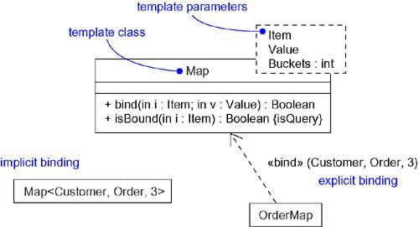
Template Classes

Slide 43
Standard Elements
All of the UML's extensibility mechanisms apply to classes.
You use tagged values to extend class properties (such as specifying the version of a class) and stereotypes to specify new kinds of components (such as model- specific components).

Slide 44
Standard Elements
The UML defines four standard stereotypes that apply to classes.
S.No | Stereotypes | Description
1 | metaclass | Specifies a classifier whose objects are all classes
2 | powertype | Specifies a classifier whose objects are the children of a given parent
3 | stereotype | Specifies that the classifier is a stereotype that may be applied to other elements
4 | utility | Specifies a class whose attributes and operations are all class scoped

Slide 45
Common Modeling Techniques
There is only one type modeling techniques for Advanced Classes.
Modeling the Semantics of a Class

Slide 46
Modeling the Semantics of a Class
To model the semantics of a class-
Specify the responsibilities of the class in a note and attach it to the class with a dependency relationship.
Specify the semantics of a class as a whole in a note stereotyped with “semantics”.

Slide 47
Modeling the Semantics of a Class
Specify the body of each method using structured text or a programming language, rendered in a note attached to the operation by a dependency relationship.
Specify the pre-conditions and post-conditions for operations using structured text in a note.

Slide 48
Modeling the Semantics of a Class
Specify a state machine for a class which represents different states the object undergoes.
Specify a collaboration that represents a class.

